Slide 1
Reinforcement Learning
Elementary Solution Methods
主讲人：傅启明
苏州科技大学

Slide 2
Content
Introduction
Dynamic Programming
Monte Carlo Methods
Temporal Difference Learning

Slide 3
Basic Methods
Dynamic programming
  well developed but require a complete and accurate model of the environment
Monte Carlo methods
  don't require a model and are very simple conceptually, but are not suited for step-by-step incremental computation
Temporal-difference learning
  temporal-difference methods require no model and are fully incremental, but are more complex to analyze
Q-Learning

Slide 4
Reinforcement Learning
Elementary Solution Methods
Dynamic Programming

Slide 5
Dynamic Programming
A collection of algorithms that can be used to compute optimal policies given a perfect model of the environment.
  e.g., a Markov decision process (MDP).
Theoretically important
  An essential foundation for the understanding of other methods.
  Other methods attempt to achieve much the same effect as DP, only with less computation and without assuming a perfect model of the environment.

Slide 6
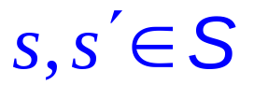
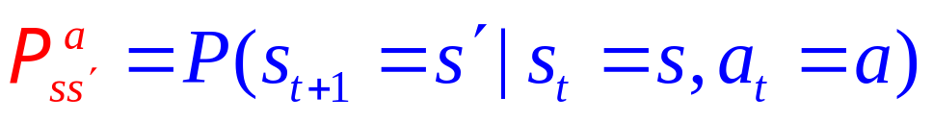

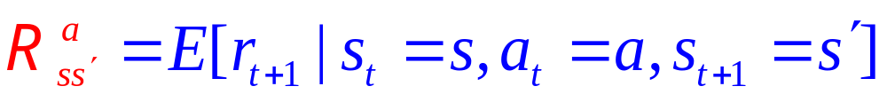
Finite MDP Environments
An MDP consists of:
  A set of finite states S,
  A set of finite actions A,
  A transition distribution
  Expected immediate rewards

Slide 7
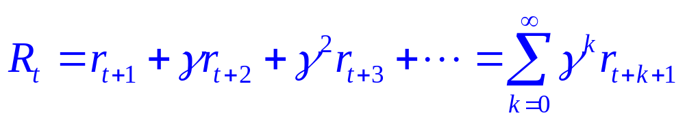
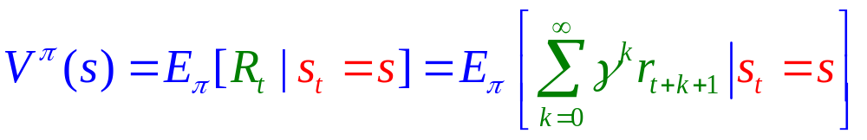
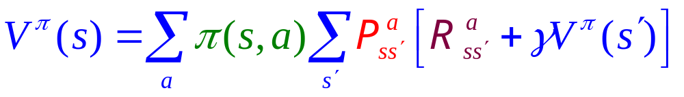
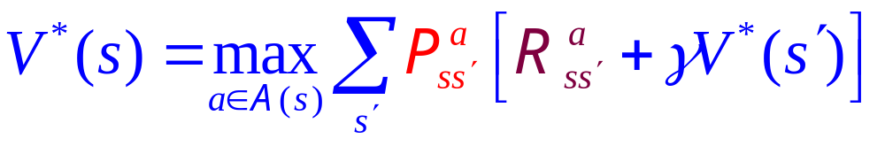
Review
State-Value function for policy π:
Bellman equation for V^{π}:
Bellman Optimality Equation:

Slide 8
Methods of Dynamic Programming
Policy Evaluation
Policy Improvement
Policy Iteration
Value Iteration
Asynchronous DP

Slide 9
Policy Evaluation
Given policy π, compute the state-value function.
Bellman equation for V^{π}:
A system of |S| linear equations.
It can be solved straightforward, but may be tedious.
We’ll use iterative method.

Slide 10
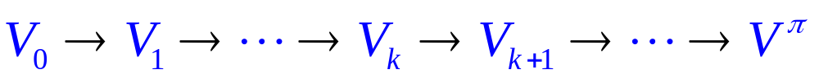
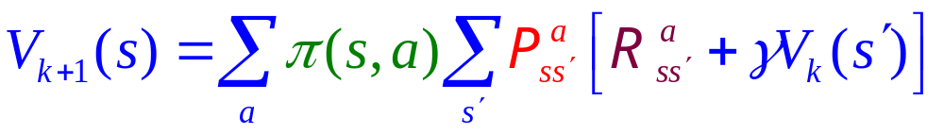
Iterative Policy Evaluation
a “sweep”
A sweep consists of applying a backup operation to each state.
full backup:

Slide 11
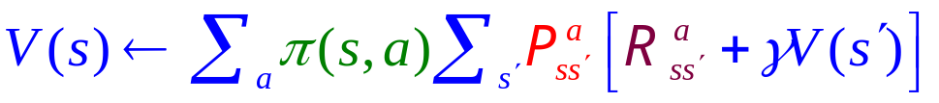
The Algorithm − Policy Evaluation
Input the policy π to be evaluated
Initialize V(s) = 0 for all s∈S⁺
Repeat
Δ ← 0
For each s∈S
v ← V(s)
Δ ← max(Δ, |v − V(s)|)
Until Δ < θ (a small positive number)
Output V ≈ V^{π}

Slide 12
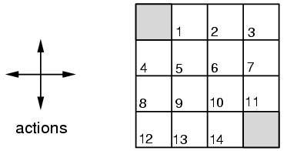
Example (Grid World)
Possible actions from any state s: A = {up, down, left, right}
Terminal state in top-left & bottom right (same state)
Reward is −1 on all transitions until terminal state is reached
All values initialized to 0
Out of bounds results in staying in same state

Slide 13
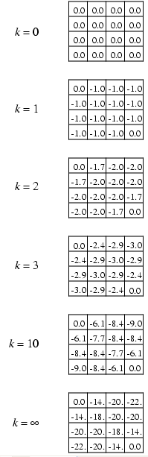
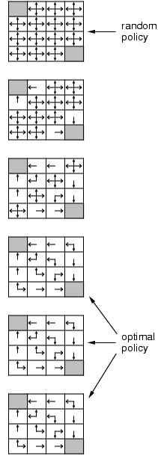
Example (Grid World)
We start with an equiprobable random policy, finally we obtain the optimal policy.

Slide 14
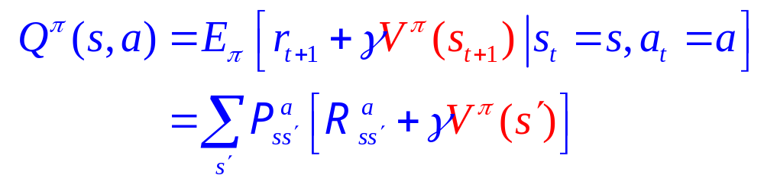
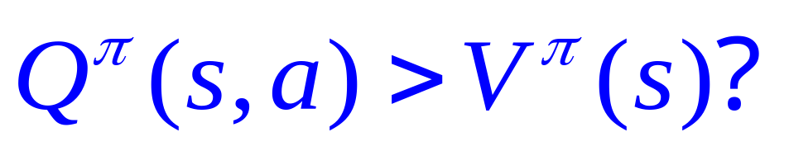
Consider V^{π} for a deterministic policy π.
Policy Improvement
In what condition, would it be better to do an action a ≠ π(s) when we are in state s?
The action-value of doing a in state s is:
Is it better to switch to action a if

Slide 15
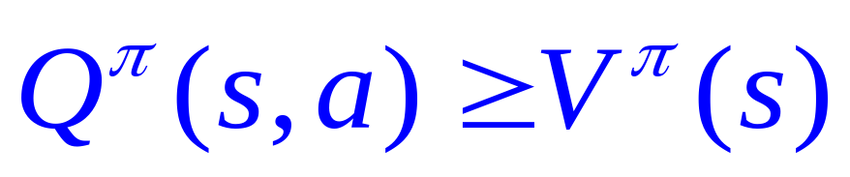
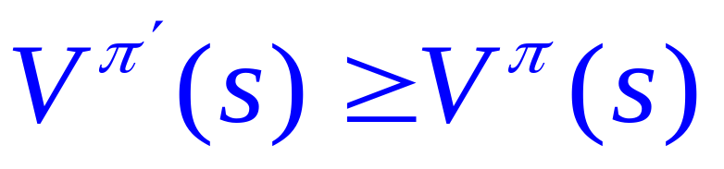
Policy Improvement
Let π’ be a policy the same as π except in state s.
Suppose that π’(s) = a and
Given a policy and its value function, we can easily evaluate a change in the policy at a single state to a particular action.

Slide 16
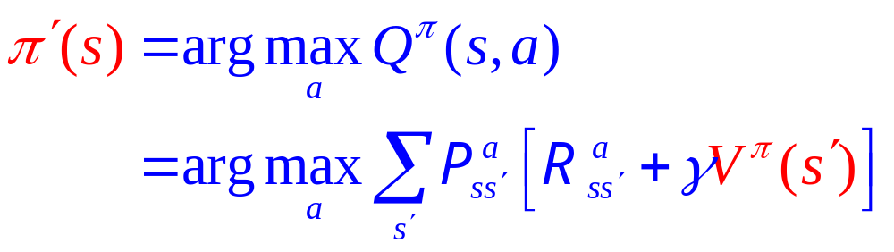
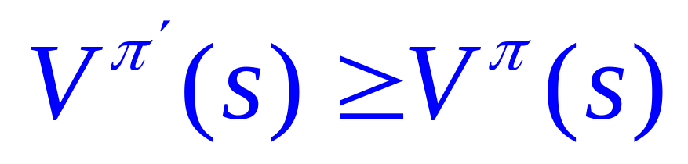
Greedy Policy π’
Selecting at each state the action that appears best according to Q^{π}(s, a).

Slide 17
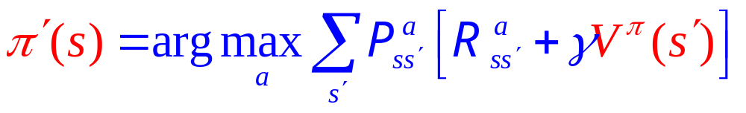
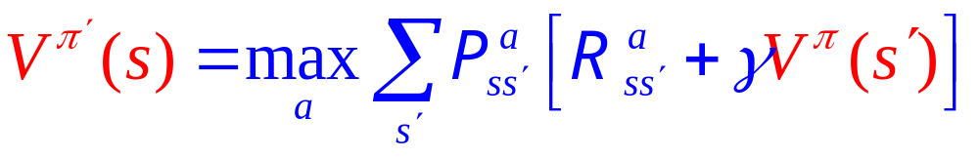
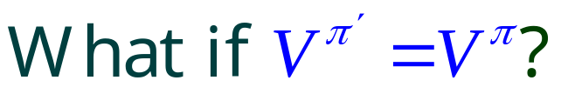
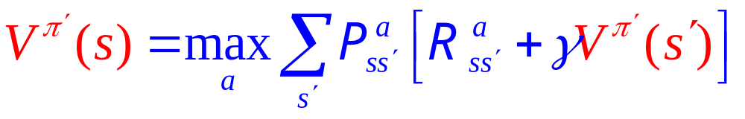
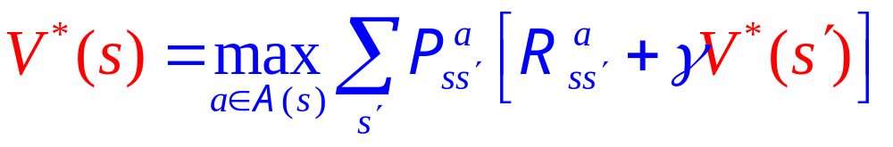
Greedy Policy π’
What can you say
about this?
Bellman Optimality Equation:

Slide 18
Policy Iteration
policy evaluation
policy improvement
“greedification”

Slide 19
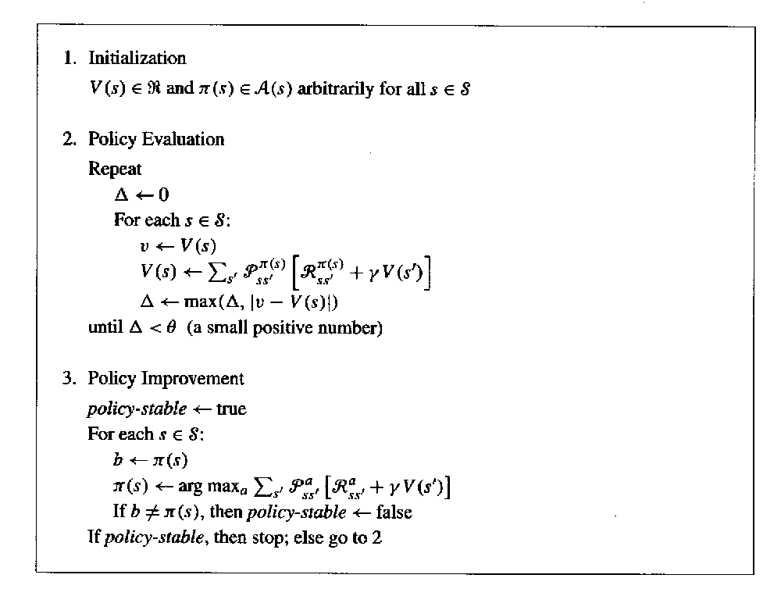
Policy Iteration
Policy Evaluation
Policy Improvement

Slide 20
Policy Iteration
Policy Evaluation
Policy Improvement
Optimal Policy

Slide 21
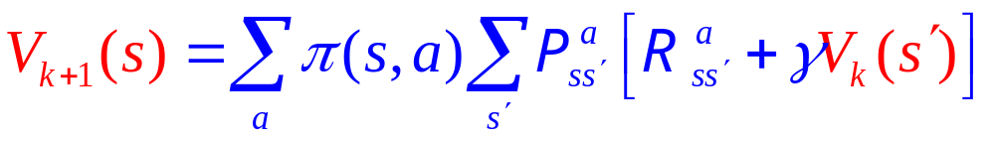
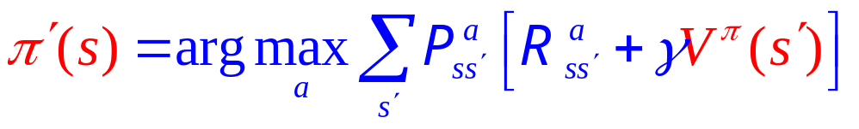
Policy Iteration
Policy Evaluation
Policy Improvement
Optimal Policy

Slide 22
Value Iteration
Policy Evaluation
Combine these two.
Policy Improvement
Optimal Policy

Slide 23
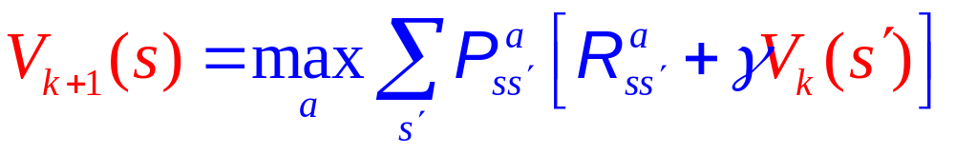
Value Iteration
Policy Evaluation
Combine these two.
Policy Improvement
Optimal Policy

Slide 24
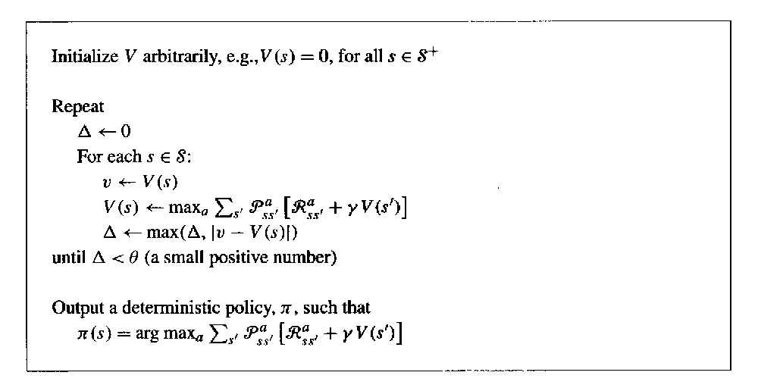
Value Iteration

Slide 25
Asynchronous DP
All the DP methods described so far require exhaustive sweeps of the entire state set.
Asynchronous DP does not use sweeps. Instead it works like this:
  Repeat until convergence criterion is met:
  Pick a state at random and apply the appropriate backup
Still need lots of computation, but does not get locked into hopelessly long sweeps
Can you select states to backup intelligently?
  YES: an agent’s experience can act as a guide.

Slide 26
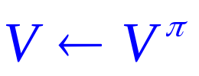

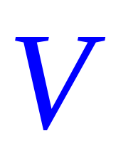
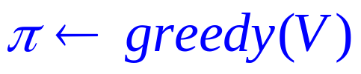
Generalized Policy Iteration (GPI)
Evaluation
Improvement
Optimal Policy

Slide 27
Efficiency of DP
To find an optimal policy is polynomial in the number of states…
BUT, the number of states is often astronomical
  e.g., often growing exponentially with the number of state variables (what Bellman called “the curse of dimensionality”).
In practice, classical DP can be applied to problems with a few millions of states.
Asynchronous DP can be applied to larger problems, and appropriate for parallel computation.
It is surprisingly easy to come up with MDPs for which DP methods are not practical.

Slide 28
Reinforcement Learning
Elementary Solution Methods
Monte Carlo Methods

Slide 29
What is Monte Carlo methods?
Monte Carlo methods ≡ Random Search Method
It does not assume complete knowledge of the environment
Learning from actual experience
  sample sequences of states, actions, and rewards from actual or simulated interaction with an environment

Slide 30
Monte Carlo methods vs. Reinforcement Learning
Monte Carlo methods are ways of solving the reinforcement learning problem based on averaging sample returns.
To ensure that well-defined returns are available, we define Monte Carlo methods only for episodic tasks.
Incremental in an episode-by-episode sense, but not in a step-by-step sense.

Slide 31
Monte Carlo methods for
Policy Evaluation ⎯ V^{π}(s)
Evaluation
Monte Carlo methods
Improvement
Optimal Policy

Slide 32
Monte Carlo methods for
Policy Evaluation ⎯ V^{π}(s)
Goal: learn V^{π}(s)
Given: some number of episodes under π which contain s
Idea: Average returns observed after visits to s
A visit to s
An episode:
⋅⋅⋅ → s → ⋅⋅⋅ s → ⋅⋅⋅ s → ⋅⋅⋅
Return(s)
Return(s)
Return(s)
The first visit to s

Slide 33
Monte Carlo methods for
Policy Evaluation ⎯ V^{π}(s)
Every-Visit MC:
  average returns for every time s is visited in an episode
First-visit MC:
  average returns only for first time s is visited in an episode
Both converge asymptotically

Slide 34
First-Visit MC Algorithm
Initialize
  π ← Policy to be evaluated
  V ← An arbitrary state value function
  Returns(s) ← An empty list for all s ∈ S
Repeat forever
  Generate episode using the policy
  For each state, s, occurring in the episode
    Get the return, R, following the first occurrence of s
    Append R to Returns(s)
    Set V(s) with the average of Returns(s)

Slide 35

Example: Blackjack
Object:
  Have your card sum be greater than the dealers without exceeding 21.
States (200 of them):
  current sum (12-21)
  dealer’s showing card (ace-10)
  do I have a useable ace?
Reward:
  +1 for winning, 0 for a draw, −1 for losing
Actions:
  stick (stop receiving cards), hit (receive another card)
Policy:
  Stick if my sum is 20 or 21, else hit

Slide 36
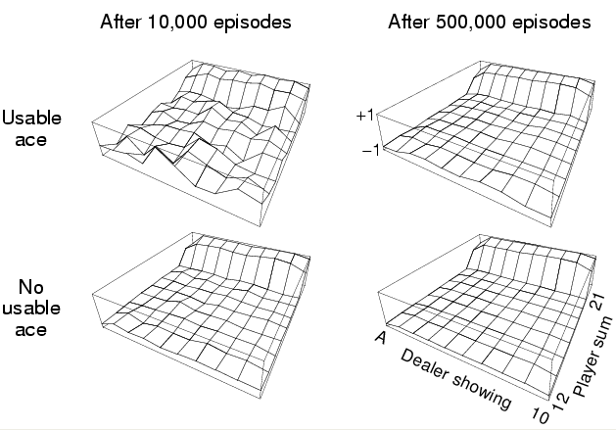
Example: Blackjack

Slide 37
Monte Carlo Estimation for
Action Values Q^{π}(s,a)
If a model is not available, then it is particularly useful to estimate action values rather than state values.
By action values, we mean the expected return when starting in state s, taking action a, and thereafter following policy π.
The every-visit MC method estimates the value of a state-action pair as the average of the returns that have followed visits to the state in which the action was selected.
The first-visit MC method is similar, but only records the first-visit (like before).

Slide 38
Maintaining Exploration
Many relevant state-action pairs may never be visited.
exploring starts
  The first step of each episode starts at a state-action pair
  Every such pair has a nonzero probability of being selected as the start.
But not a great idea to do in practice.
  It's better to just choose a policy which has a nonzero probability of selecting all actions.

Slide 39
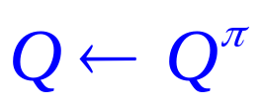

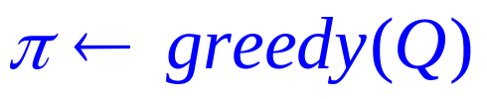
Monte Carlo Control to Approximate Optimal Policy
Evaluation
Improvement
Optimal Policy

Slide 40
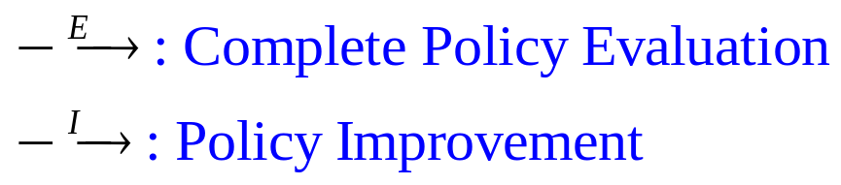
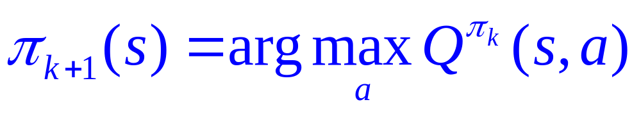
Monte Carlo Control to
Approximate Optimal Policy

Slide 41
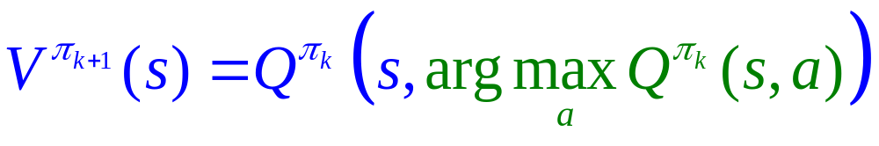
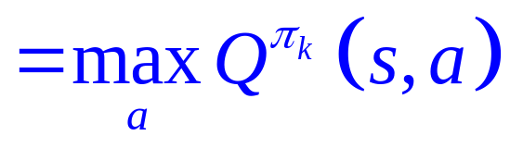
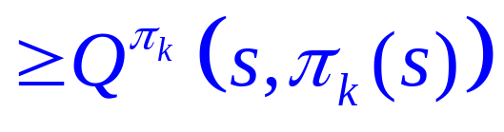
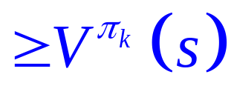
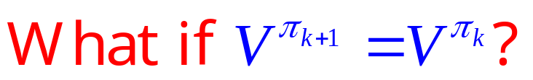
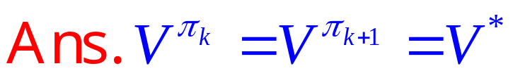
Monte Carlo Control to
Approximate Optimal Policy

Slide 42
Monte Carlo Control to
Approximate Optimal Policy
This, however, requires that
  Exploration starts with each state-action pair having nonzero probability to be selected as the start.
  Infinite number of episodes.

Slide 43
A Monte Carlo Control Algorithm Assuming Exploring Starts
Initialize
  Q(s, a) ← arbitrary
  π(s) ← arbitrary
  Returns(s, a) ← empty list
Repeat forever
  Generate an episode using π
  For each pair (s, a) appearing in the episode
    R ← return following the first occurrence of (s, a)
    Append R to Returns(s, a)
    Q(s, a) ← average of Returns(s, a)
  For each s in the episode
    π(s) ← arg max_{a} Q(s, a)

Slide 44
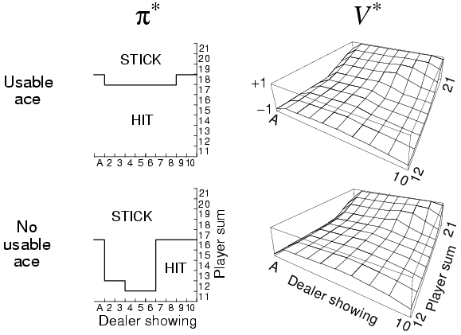
Exploring starts
Initial policy as described before
Example: Blackjack

Slide 45
On-Policy Monte Carlo Control
On-Policy
  Learning from the current executing policy
What if we don't have exploring starts?
We must adopt some method of exploring states which would not have been explored otherwise.
We will introduce the ε–greedy method.

Slide 46
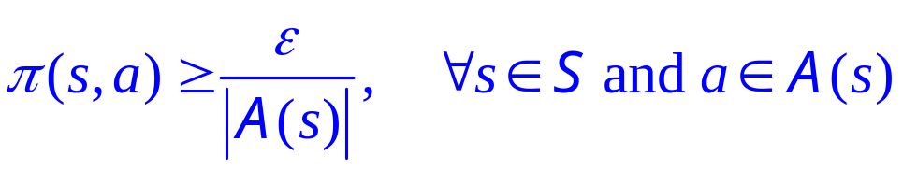
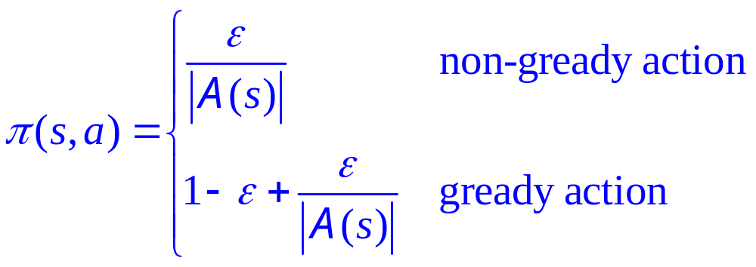
ε-Soft and ε-Greedy
ε-soft policy:
ε-greedy policy:

Slide 47

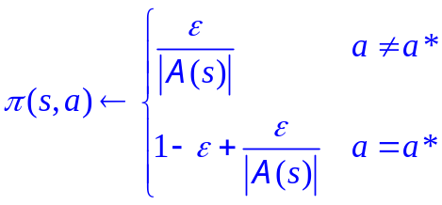
ε-Greedy Algorithm
Initialize for all states, s, and actions, a.
  Q(s, a) ← arbitrary.
  Returns(s, a) ← empty list.
  π ← an arbitrary ε -soft policy
Repeat Forever:
  Generate an episode using π.
  For each (s, a) appearing in the episode.
    R ← return following the first occurrence of (s, a)
    Append R to Returns(s, a)
    Q(s, a) ← average of Returns(s, a)
  For each state, s, in the episode:
For all a ∈ A(s)

Slide 48
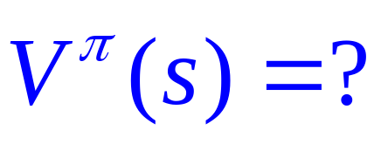
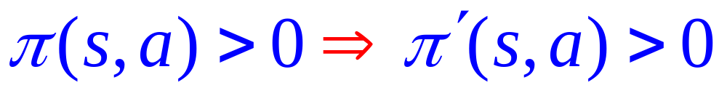
Evaluating One Policy While Following Another
Goal:
Episodes:
Generated using π’
Assumption:
How to evaluate V^{π}(s) using the episodes generated by π’?

Slide 49

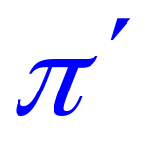




Evaluating One Policy While Following Another
s
s
. . . . .
. . . . .
. . . . .
. . . . .

Slide 50



Evaluating One Policy While Following Another
s
. . . . .
. . . . .

Slide 51


Evaluating One Policy While Following Another
Suppose n_{s} samples are taken using π’
s
s
. . . . .
. . . . .
. . . . .
. . . . .

Slide 52






Evaluating One Policy While Following Another
i^{th} first visit to state s
S
S

Slide 53



Evaluating One Policy While Following Another
i^{th} first visit to state s
S
S

Slide 54
How to approximate Q^{π}(s, a)?
Summary

Slide 55






How to approximate Q^{π}(s, a)?
Evaluating One Policy While Following Another
s
s
a
a
. . .
. . .
. . .
. . .
. . . . .
. . . . .
. . . . .
. . . . .

Slide 56
How to approximate Q^{π}(s, a)?
To obtain Q^{π}(s, a),
set π(s, a) = 1
Evaluating One Policy While Following Another
s
s
a
a
. . .
. . .
. . .
. . .
. . . . .
. . . . .
. . . . .
. . . . .

Slide 57


How to approximate Q^{π}(s, a)?
To obtain Q^{π}(s, a),
set π(s, a) = 1
Evaluating One Policy While Following Another
s
s
a
a
. . .
. . .
. . .
. . .
. . . . .
. . . . .
. . . . .
. . . . .

Slide 58



How to approximate Q^{π}(s, a)?
To obtain Q^{π}(s, a),
set π(s, a) = 1
Evaluating One Policy While Following Another
s
s
a
a
. . .
. . .
. . .
. . .
. . . . .
. . . . .
. . . . .
. . . . .

Slide 59


How to approximate Q^{π}(s, a)?
Evaluating One Policy While Following Another
s
s
a
a
. . .
. . .
. . .
. . .
. . . . .
. . . . .
. . . . .
. . . . .

Slide 60
Off-Policy Monte Carlo Control
Require two policies.
  estimation policy (deterministic)
    E.g., greedy
  behaviour policy (stochastic)
    E.g., ε-soft

Slide 61

Off-Policy Monte Carlo Control
Policy
Evaluation
Policy Improvement

Slide 62
Incremental Implementation
MC can be implemented incrementally
  saves memory
Compute the weighted average of each return

Slide 63




Incremental Implementation
incremental
equivalent
non-incremental

Slide 64
Incremental Implementation
incremental
equivalent
If α_{t} is held constant, it is called the constant-α MC.
non-incremental

Slide 65
Summary
MC has several advantages over DP:
  Can learn directly from interaction with environment
  No need for full models
  No need to learn about ALL states
  Less harm by Markovian violations
MC methods provide an alternate policy evaluation process
One issue to watch for: maintaining sufficient exploration
  exploring starts, soft policies
No bootstrapping (as opposed to DP)

Slide 66
Reinforcement Learning
Elementary Solution Methods
Temporal Difference Learning

Slide 67
Temporal Difference Learning
Combine the ideas of Monte Carlo and dynamic programming (DP).
Like Monte Carlo methods, TD methods can learn directly from raw experience without a model of the environment's dynamics.
Like DP, TD methods update estimates based in part on other learned estimates, without waiting for a final outcome (they bootstrap).

Slide 68


Monte Carlo Methods
T
T
T
T
T
T
T
T
T
T
T
T
T
T
T
T
T
T
T
T

Slide 69



Dynamic Programming
T
T
T
T
T
T
T
T
T
T
T
T
T

Slide 70



Basic Concept of TD(0)
Dynamic Programming
Monte Carlo Methods
True
return
TD(0):
Predicted value
on time t + 1
Temporal Difference

Slide 71


Basic Concept of TD(0)
s
t
T
T
T
T
T
T
T
T
T
T
T
T
T
T
T
T
T
T
T
T

Slide 72
TD(0) Algorithm
Initialize V (s) arbitrarily for the policy π to be evaluated
Repeat (for each episode):
  Initialize s
  Repeat (for each step of episode):
    a ← action given by π for s
    Take action a; observe reward, r, and next state, s’
    V(s) ← V(s) + α[r + V(s’) − V(s) ]
    s ← s’
  until s is a terminal

Slide 73
Example (Driving Home)
Elapsed Time
(minutes)
Predicted
Time to Go
Predicted
Total Time
State
Leaving office
0
30
30
Reach car, Raining
5
35
40
Exit highway
20
15
35
Behind truck
30
10
40
Home street
40
3
43
Arrive home
43
0
43

Slide 74


Example (Driving Home)
Elapsed Time
(minutes)
Predicted
Time to Go
Predicted
Total Time
State
Leaving office
0
30
30
Reach car, Raining
5
35
40
Exit highway
20
15
35
Behind truck
30
10
40
Home street
40
3
43
Arrive home
43
0
43

Slide 75
TD Bootstraps and Samples
Bootstrapping: update involves an estimate
  MC does not bootstrap
  DP bootstraps
  TD bootstraps
Sampling: update does not involve an expected value
  MC samples
  DP does not sample
  TD samples

Slide 76
Example (Random Walk)
start
0
A
0
B
0
C
0
D
0
E
1
V^{π}(s)
1/6
2/6
3/6
4/6
5/6

Slide 77

Example (Random Walk)
start
0
A
0
B
0
C
0
D
0
E
1
Values learned by TD(0) after various numbers of episodes

Slide 78

Example (Random Walk)
start
0
A
0
B
0
C
0
D
0
E
1
    Data averaged over
    100 sequences of episodes

Slide 79
Optimality of TD(0)
Batch Updating: train completely on a finite amount of data, e.g., train repeatedly on 10 episodes until convergence.
  Compute updates according to TD(0), but only update estimates after each complete pass through the data
For any finite Markov prediction task, under batch updating
  TD(0) converges for sufficiently small a.
  Constant-α MC also converges under these conditions, but to a difference answer!

Slide 80

Example:
Random Walk under Batch Updating
After each new episode, all previous episodes were treated as a batch, and algorithm was trained until convergence. All repeated 100 times.

Slide 81
Why is TD better at generalizing in the batch update?
MC susceptible to poor state sampling and weird episodes
TD less affected by weird episodes & sampling because estimates linked to other states that may be better sampled
  i.e., estimates smoothed across states.
TD converges to correct value function for max likelihood model of the environment (certainty-equivalence estimate)

Slide 82


What for TD(0)?
What for constant-α MC?
Example: You are the predictor
Suppose you observe the following 8 episodes from an MDP:
A, 0, B, 0
B, 1
B, 1
B, 1
B, 1
B, 1
B, 1
B, 0
1
75%
A
0
B
100%
0
25%
What by you?

Slide 83


Learning An Action-Value Function
r_{t+1}
r_{t+2}
s_{t}
s_{t+1}
s_{t+2}
s_{t}, a_{t}
s_{t+1}, a_{t+1}
s_{t+2}, a_{t+2}
After every transition from a nonterminal state s_{t}, do:
If s_{t+1} is a terminal, then

Slide 84
Sarsa: On-Policy TD Control
Initialize Q (s, a) arbitrarily
Repeat (for each episode):
  Initialize s
  Repeat (for each step of episode):
    Choose a from s using policy derived from Q (e.g., ε-greedy)
    Take action a; observe reward, r, and next state, s’
    Choose a’ from s’ using policy derived from Q (e.g., ε-greedy)
    Q(s, a) ← Q(s, a) + α[r + Q(s’, a’) − Q(s, a)]
    s ← s’, a ← a’
  until s is a terminal

Slide 85


Example (Windy World)
Standard
moves
King’s
moves
undiscounted, episodic, reward = –1 until goal

Slide 86

Applying ε-greedy Sarsa to this task, with α = 0.1, ε = 0.1, and the initial values Q(s, a) = 0 for all s, a.
Example (Windy World)

Slide 87

Q-Learning: Off-Policy TD Control
One-step Q-Learning:
Stochastic
policy
Deterministic
policy

Slide 88
Q-Learning: Off-Policy TD Control
Initialize Q (s, a) arbitrarily
Repeat (for each episode):
  Initialize s
  Repeat (for each step of episode):
    Choose a from s using policy derived from Q (e.g., ε-greedy)
    Take action a; observe reward, r, and next state, s’
    Choose a’ from s’ using policy derived from Q (e.g., ε-greedy)
    s ← s’
  until s is a terminal

Slide 89


Example (Cliff Walking)

Slide 90
Actor-Critic Methods
Explicit representation of policy as well as value function
Minimal computation to select actions
Can learn an explicit stochastic policy
Can put constraints on policies
Appealing as psychological and neural models
Actor
Policy
Critic
TD
error
Value
Function
Action
state
reward
Environment

Slide 91




Actor-Critic Methods
Policy Parameters:
Actor
preference
Policy
Policy:
Critic
TD
error
Value
Function
Action
state
reward
TD Error:
Environment

Slide 92
Actor-Critic Methods
How to update policy parameters?
Policy Parameters:
Actor
preference
Policy
Policy:
Critic
TD
error
Value
Function
Action
Update state-value function using TD(0)
state
reward
TD Error:
Environment

Slide 93


>
=
<
0
We are tend to maximize the value.
Actor-Critic Methods
How to update policy parameters?
Method 1:
Actor
Policy
Method 2:
Critic
TD
error
Value
Function
Action
state
reward
TD Error:
Environment

